Slide 1
IT420: Selected Topics in IT Mobile Application Development
Lecture 5: The User Interface

Slide 2
Lecturer Details
Dr. Walid Khedr
Email: khedrw@yahoo.com
Web: www.staff.zu.edu.eg/wkhedr
Department of Information Technology

Slide 3
Introduction
A layout defines what a screen looks like, and you define it using XML.
Layouts usually contain GUI components such as buttons and text fields.
All the apps you’ve seen in the book so far have used relative and linear layouts.
We’re going to introduce some of the other layouts you’ll want to use in your apps, and also more of the GUI components you can use to make your app more interactive.

Slide 4
Relative, Linear, and Grid Layout
Layouts come in several flavors, and each one has their own policy to follow. Here are three of the key ones:
A relative layout displays its views in relative positions
A linear layout displays views next to each other either vertically or horizontally
A grid layout divides the screen into a grid of rows, columns, and cells

Slide 5
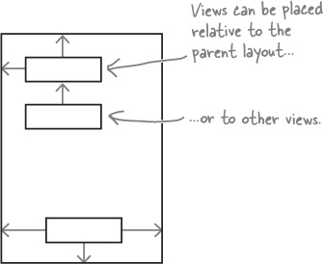
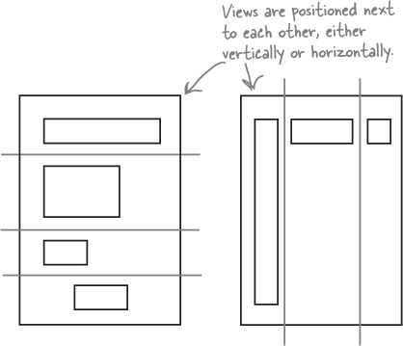
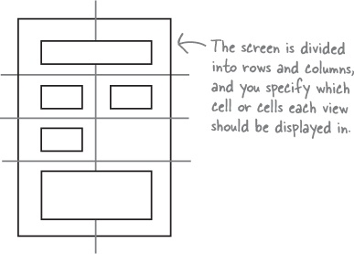
`

Slide 6
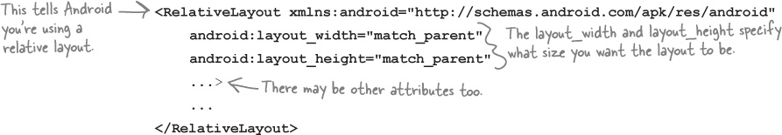
RelativeLayout
What are density-independent pixels?
Some devices create very sharp images by using very tiny pixels. Other devices are cheaper to produce because they have fewer, larger pixels

Slide 7
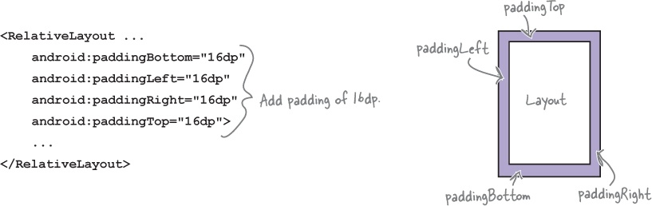
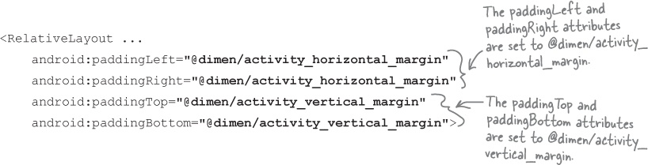
Adding padding

Slide 8
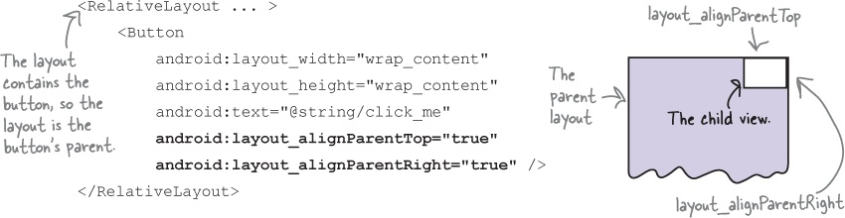
Positioning views relative to the parent layout

Slide 9
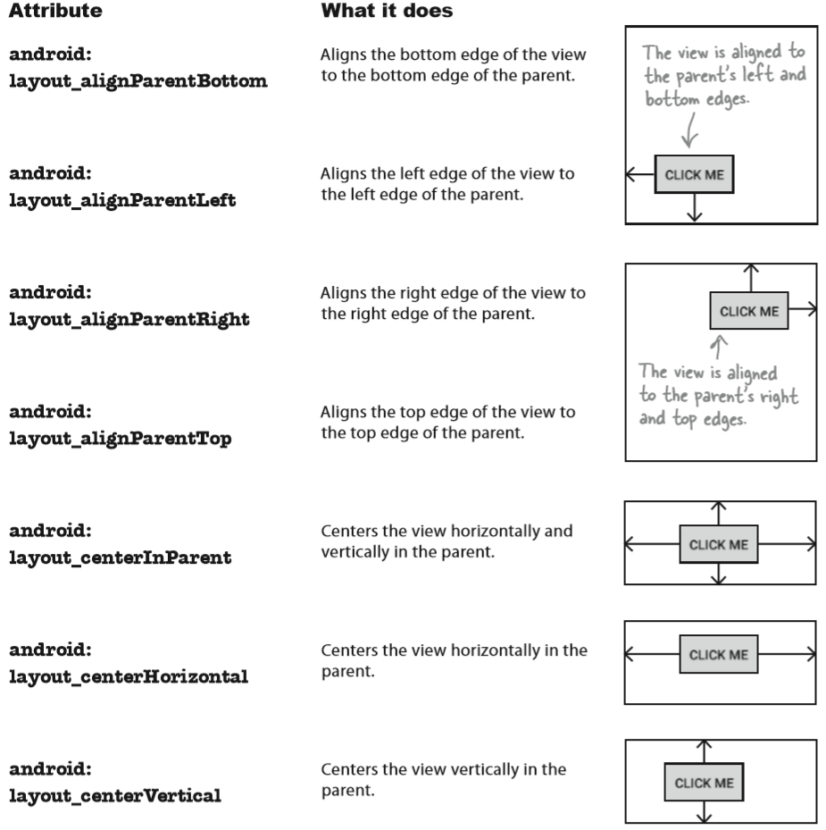

Slide 10
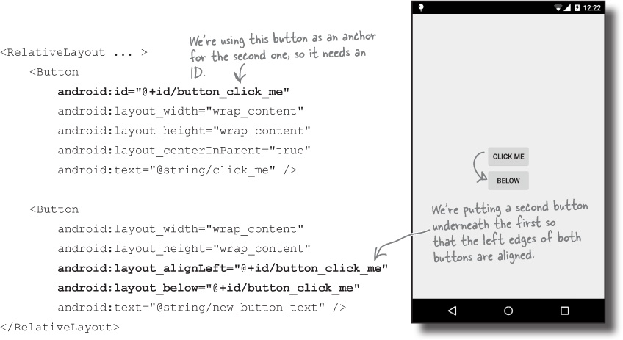
Positioning views relative to other views

Slide 11
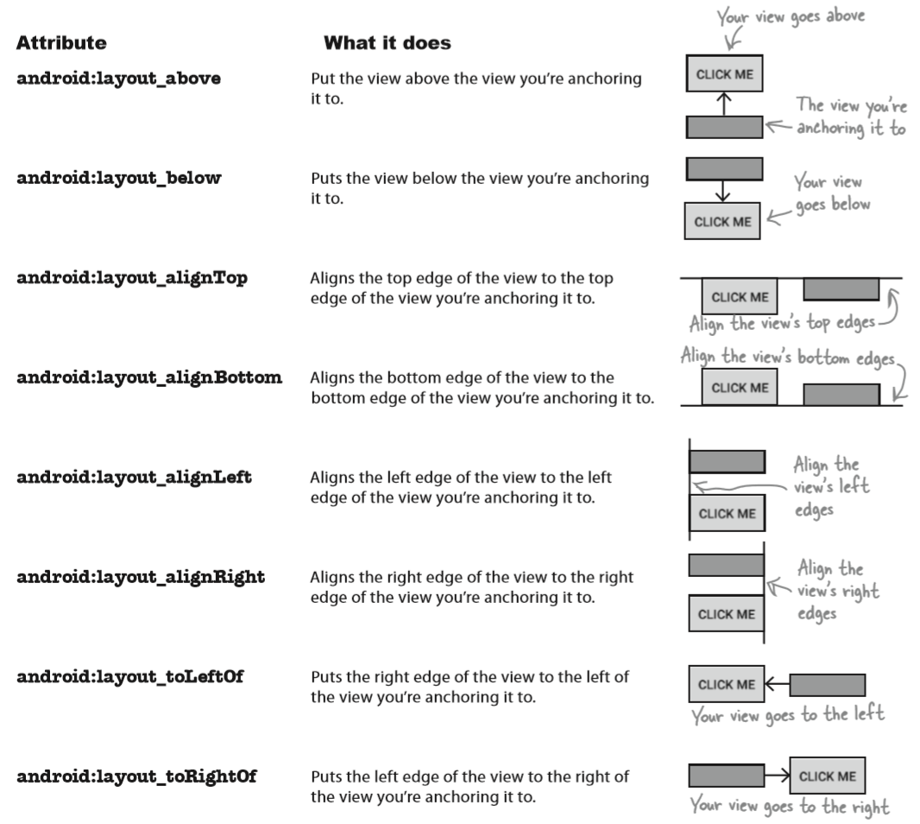

Slide 12
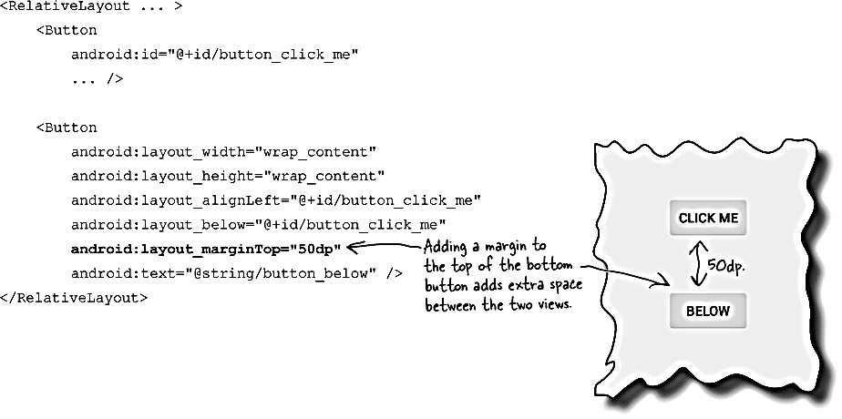
Use margins to add distance between views

Slide 13
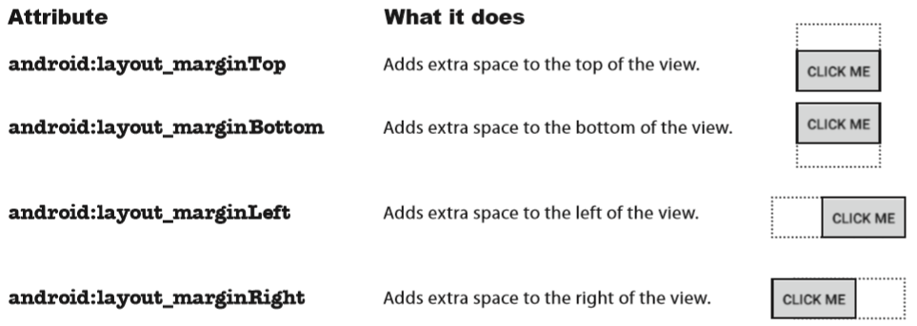
Use margins to add distance between views

Slide 14
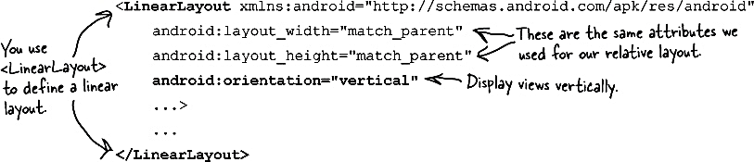
LinearLayout
A linear layout displays its views next to each other, either vertically or horizontally.
If it’s vertically, the views are displayed in a single column. If it’s horizontally, the views are displayed in a single row.

Slide 15
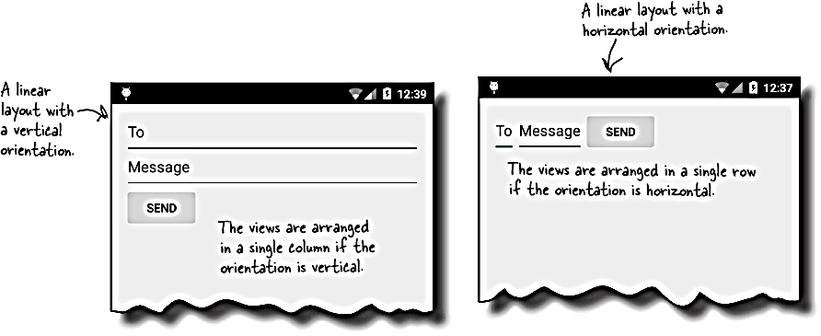

Slide 16
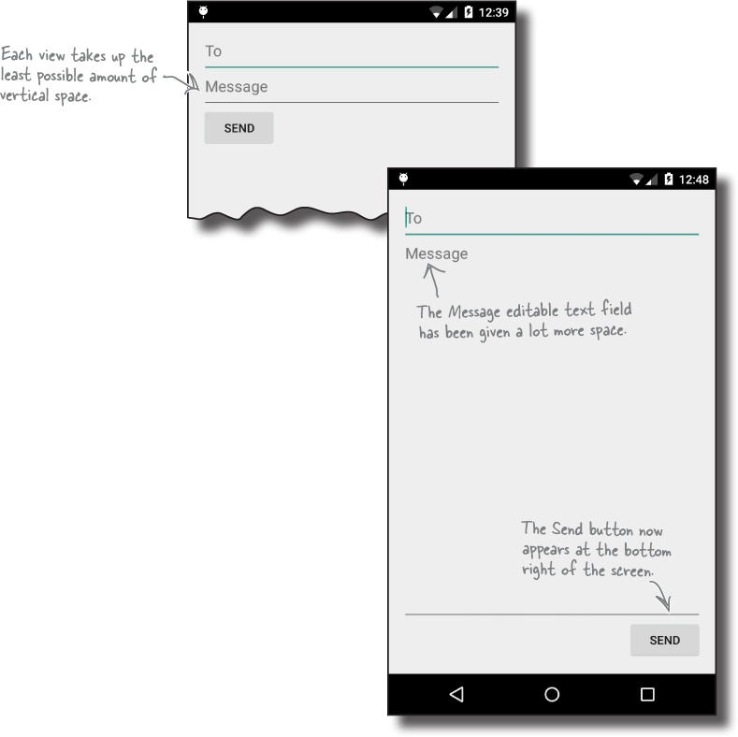
Tweak your layouts appearance

Slide 17
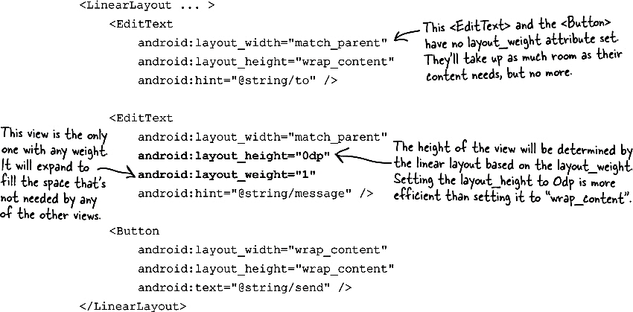
Adding weight to one view
We need the Message editable text field to take up any extra space in the layout.
To do this, we’ll set its layout_weight attribute to 1.

Slide 18
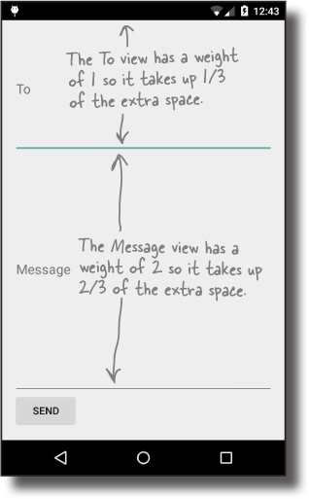
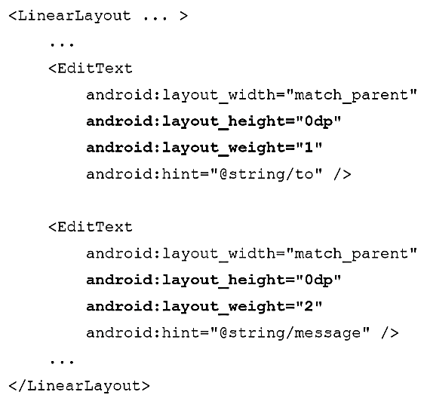
Adding weight to multiple views
Suppose we gave the To text field a weight of 1, and the Message text field a weight of 2 like this:

Slide 19
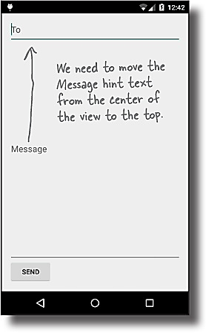
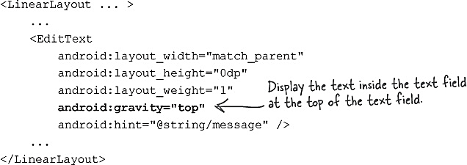
Using gravity
The android:gravity attribute lets you specify how you want to position the contents of a view inside the view

Slide 20
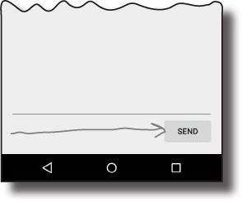
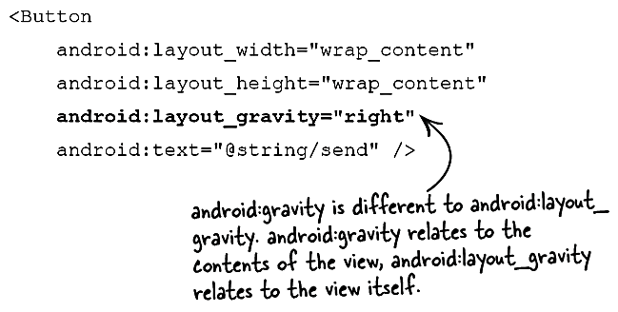
Move the button to the right with layout-gravity
The android:layout_gravity attribute lets you specify where you want a view in a linear layout to appear in its enclosing space

Slide 21
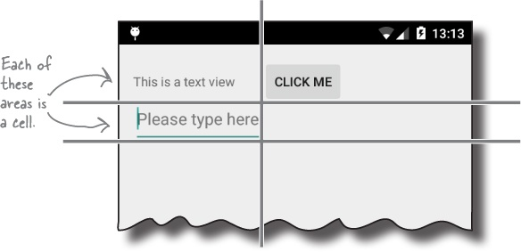
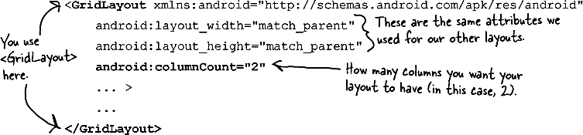
GridLayout
A grid layout splits the screen up into a grid of rows and columns, and allocates views to cells
If you plan on using a grid layout, make sure your app uses a minimum SDK of API 14.

Slide 22
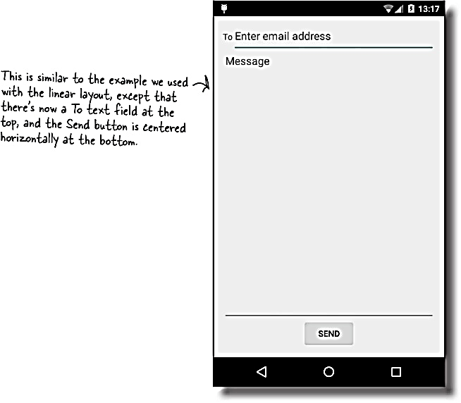
Let’s create a new grid layout

Slide 23
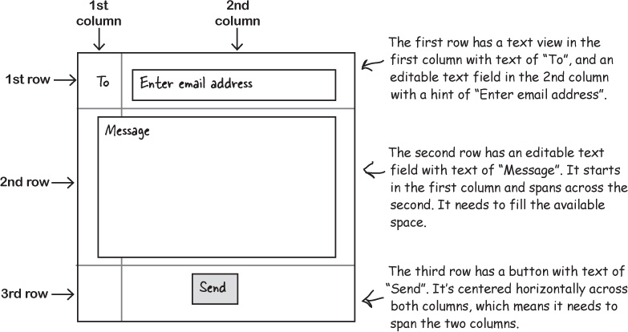
Let’s create a new grid layout

Slide 24
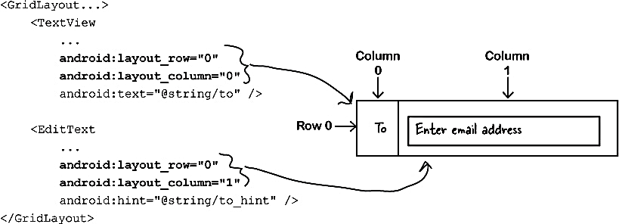
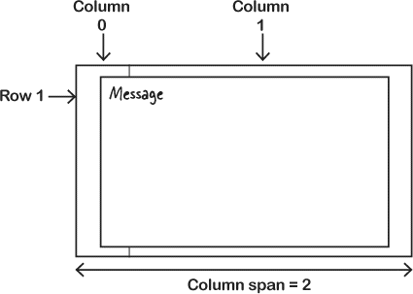
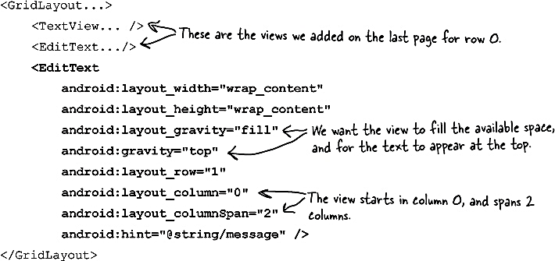

Slide 25
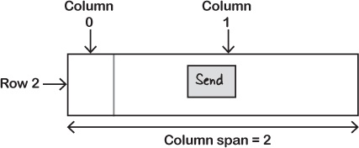
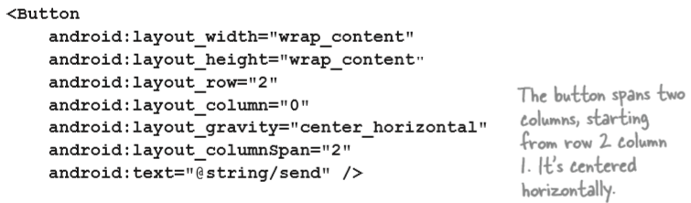

Slide 26
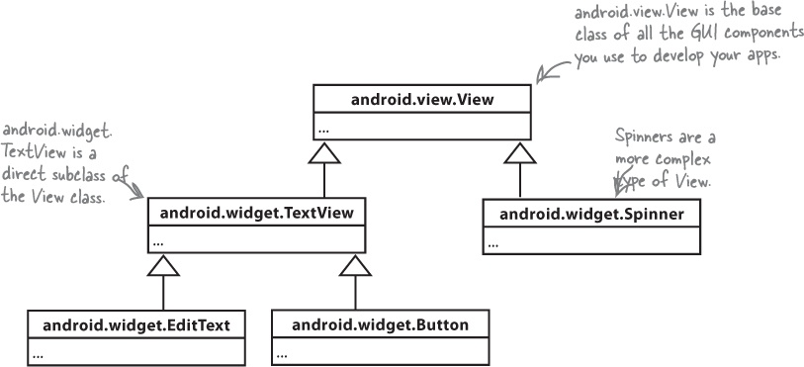
GUI Components
All layouts and GUI components are subclasses of the Android View

Slide 27
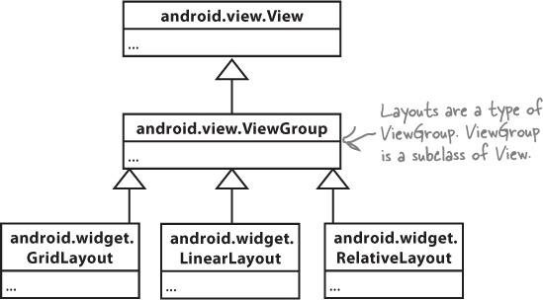
Layouts are a type of View called a ViewGroup
A layout is a type of view group, which is a special type of view that can contain other views.

Slide 28
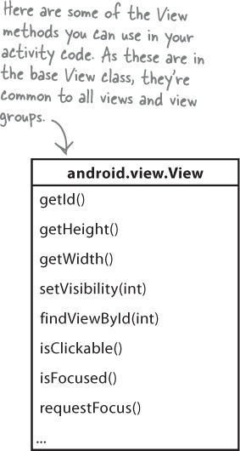
Getting and setting view properties
Each view is a Java object behind the scenes, and that means you can get and set its properties in your activity code

Slide 29
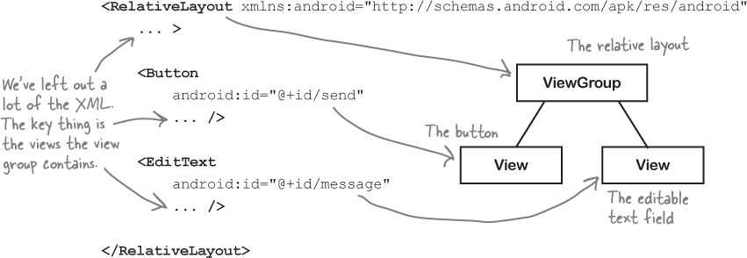
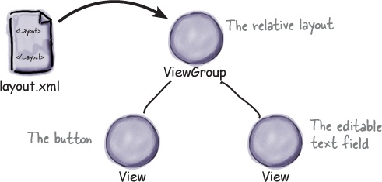
A layout is really a hierarchy of Views

Slide 30
The most common GUI components
Text view
Edit Text
Button
Toggle button
Switch
Check boxes
Radio buttons
Spinner
Image views
Image Button
Scroll views
Toasts

Slide 31
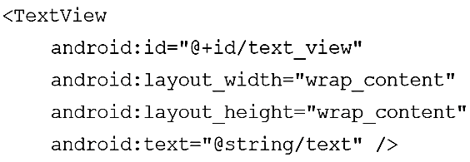
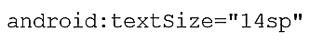
Text view

Slide 32
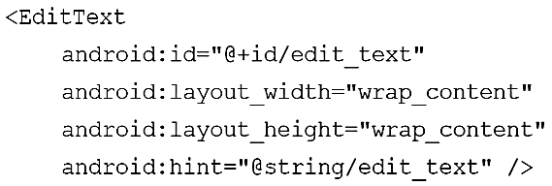
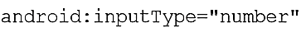
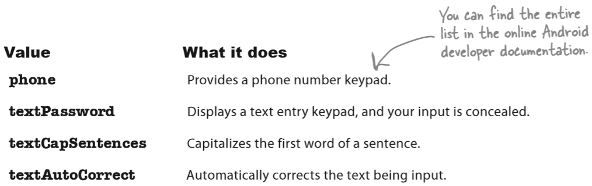
Edit Text

Slide 33
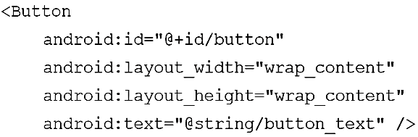
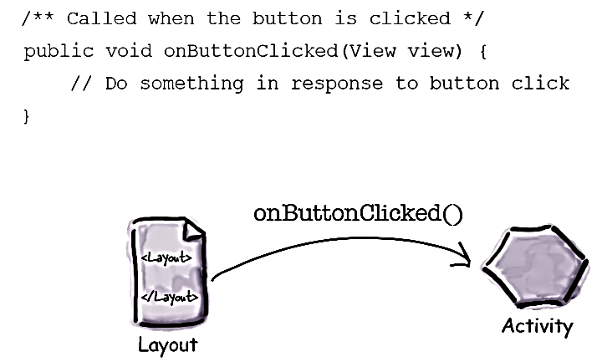
Button

Slide 34
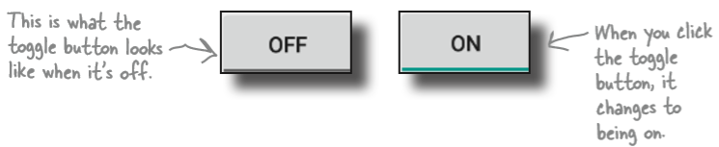
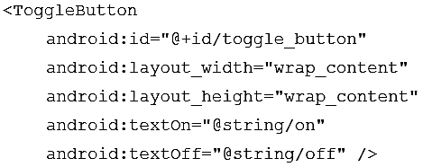
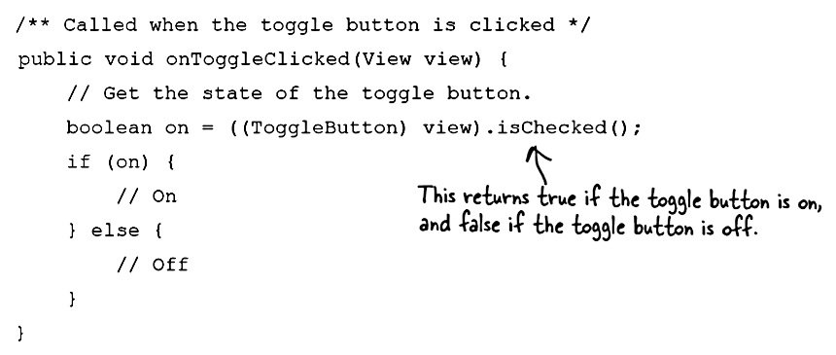
Toggle button

Slide 35
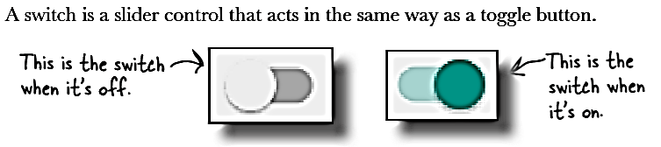
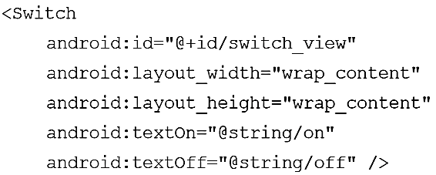
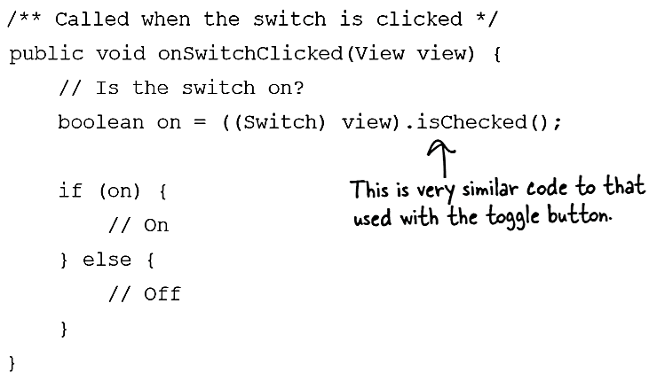
Switch

Slide 36
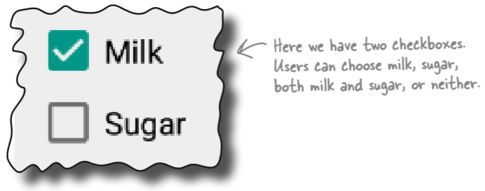


Check boxes

Slide 37

Check boxes

Slide 38


Slide 39


Radio buttons

Slide 40



Slide 41



Spinner

Slide 42

Image views
You use an image view to display an image
Add an image file to your project as a drawable resource. Under app/src/main/res folder in your project
You can use different image files depending on the screen density of the device.

Slide 43


Image views

Slide 44



Adding images to buttons

Slide 45



Image Button
An image button is just like a button, except it contains an image and no text.

Slide 46

Scroll views
Most layouts don’t come with scrollbars to allow you to scroll down the page
To add a vertical scrollbar to your layout, you surround your existing layout with a <ScrollView> element
To add a horizontal scrollbar to your layout, wrap your existing layout inside a <HorizontalScrollView> element instead

Slide 47
Toasts
A toast is a simple pop-up message you can display on the screen.
Toasts are purely informative, as the user can’t interact with them.
While a toast is displayed, the activity stays visible and interactive.
The toast automatically disappears when it times out

Slide 48

Toasts

Slide 49

Constraint Layouts
When Android displays a layout on the device screen, it creates a hierarchy of views based on the layout components which helps it figure out where each view should be placed.
If the layout contains nested layouts, the hierarchy is more complex, and Android may need to make more than one pass through the hierarchy

Slide 50
Introducing the constraint layout
This type of layout is more complex than a linear or frame layout, but it’s a lot more flexible.
It’s als much more efficient for complex UIs as it gives you a flatter view hierarchy, which means that Android has less processing to do at runtime.
To build constraint layouts using the visual tools, you need Android Studio 2.3 or above

Slide 51

You design constraint layouts VISUALLY
They’re specifically designed to work with Android Studio’s design editor.
You drag and drop GUI components onto the design editor’s blueprint tool, and give it instructions for how each view should be displayed.

Slide 52

Use the blueprint tool

Slide 53

Position views using constraints
You specify placement by defining constraints.
A constraint is a connection or attachment that tells the layout where the view should be positioned.
For example, you can use a constraint to attach a view to the start edge of the layout, or underneath another view.
Each view in a constraint layout must have at least two constraints — a horizontal constraint and a vertical one — in order to specify where it should be positioned

Slide 54


Changing the view’s margins

Slide 55


How to center views

Slide 56


How to change a view’s size
Make the view a fixed size
Make it just big enough

Slide 57


How to change a view’s size
Match the view’s constraints
Specify the width:height ratio

Slide 58



How to align views

Slide 59


Slide 60
Next Lecture
Chapter 6: List views and adapters

